Slide 1

ONLINE DIAGNOSTIC LAB SYSTEM

Slide 2
Presented By
Bushra Jabeen (SP19-BSE-003)
Fahad Haider(SP19-BSE-004)
M. Saif-Ullah(SP19-BSE-015)

Slide 3

Contents
Introduction
Problem Statement
Methodology
Functional Requirements and Non Functional Requirements
Tools And Techniques
Flow Chart Diagram
Use Case Diagrams
Sequence Diagram
Class Diagram
Screens
Conclusion

Slide 4
Introduction:
Online Diagnostic Lab System is designed for Any Diagnostic Center to replace their existing manual paper-based system.
The Online Diagnostic Lab system started as a system to keep a record of test and their results .This system involves patient personal information, staff information, and test information including schedules and results, and payment history these services are to be provided in an efficient manner.
It is faster and reliable, provides better services as compared to a manual system.
The Online Diagnostic Lab system can manage and update the progress in tests and can also update the result of the tests to the database in real-time.
The main thing in our system is to take reviews by patients based on best performance lab and our system recommends the best lab to the customers by using customers reviews

Slide 5
Problem Statement
There is no specific platform that includes several labs at the same place.
There is no comparison of test’s prices and performance of labs with different labs.
Customers can only get a specific report of test and no other system can access their recent reports and no report tracking system.
Online payments are secure with stripe.

Slide 6
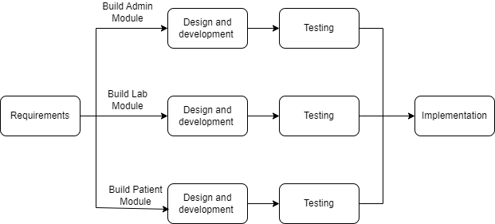
Methodology
We used incremental model for the development of this system.

Slide 7
Functional Requirements
Admin module
Login
View reports
manage accounts
Lab module
Login
Upload and edit test reports
Check transaction report
Patient module
Login
Search test for diagnose
Request for collect sample
View and download reports
Give payment
Give feedback

Slide 8
Non Functional Requirement
Usability
Performance
Security
Portability
Modifiability

Slide 9
Tools and Technologies
Tools & Technologies | Tools | Version | Rationale
 | Sublime text | 2021 | Editor
 | Laragon | 8.0.15 | Database Tool
 | MS Professional | 2016 | Gantt Chart, Use Case, Incremental Model Diagram, Flowchart, Activity Diagram.
 | MS Word 2020 | 2.0.5 | Documentation
 | MS PowerPoint | 2.0.5 | Presentation
 | Technology | Version | Rationale
 | PHP | 8.1 | Programming language
 | Laravel | 9 | Programming language
 | MySQL | 2022 | Database
 | HTML | 5 | Web Development
 | CSS | 3 | Style
 | MDbootstrap | 5.0 | Responsiveness
 | JavaScript |  | Web Behavior

Slide 10
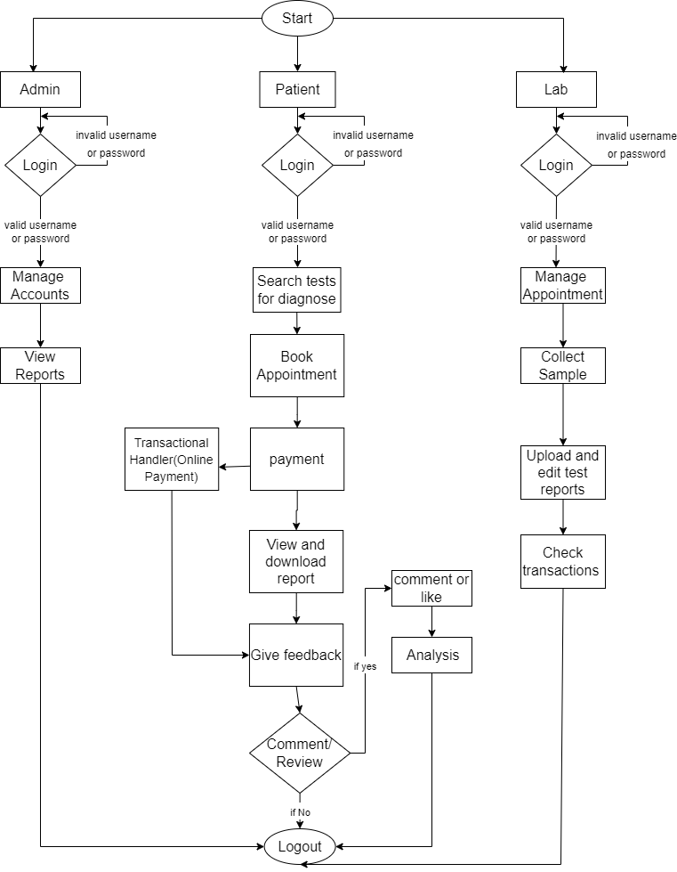
Flow Chart Diagram

Slide 11
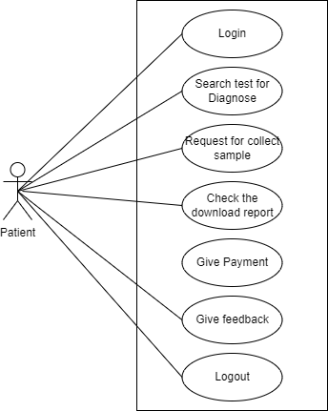
Use case Diagrams
Patient

Slide 12
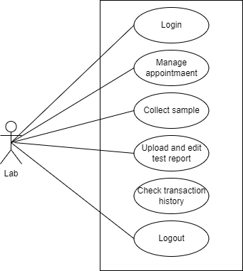
Lab

Slide 13
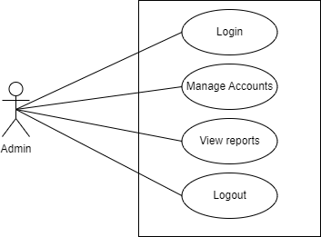
Admin

Slide 14
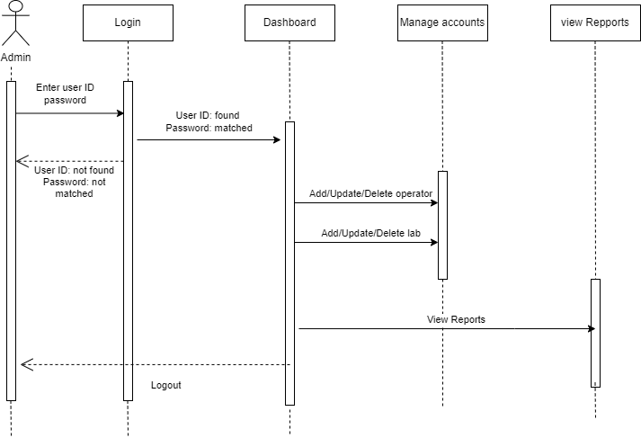
Sequence Diagram
Admin

Slide 15
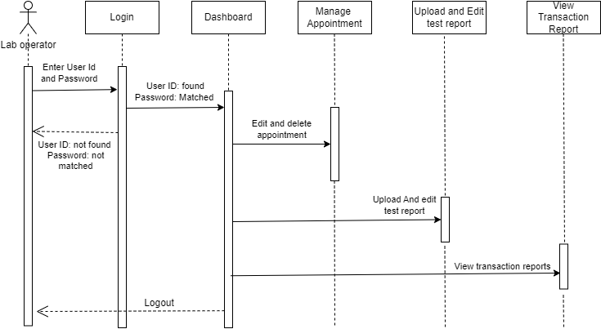
Lab

Slide 16
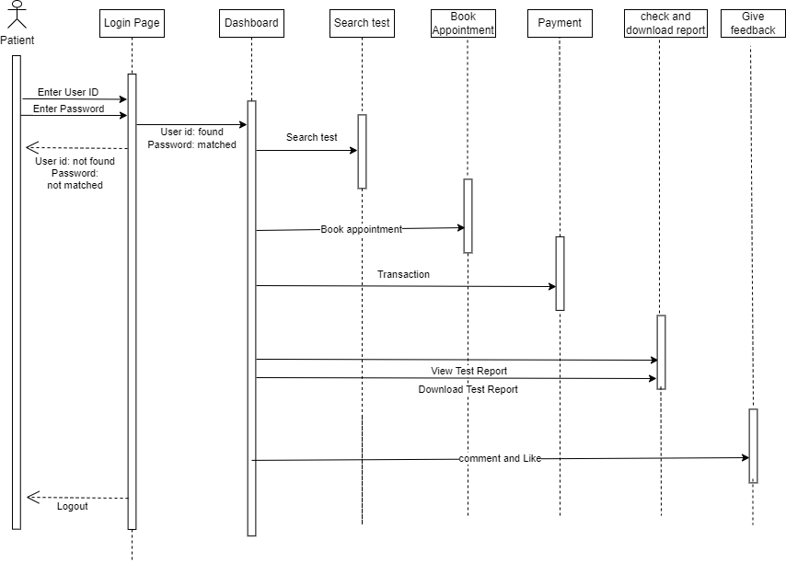
patient

Slide 17
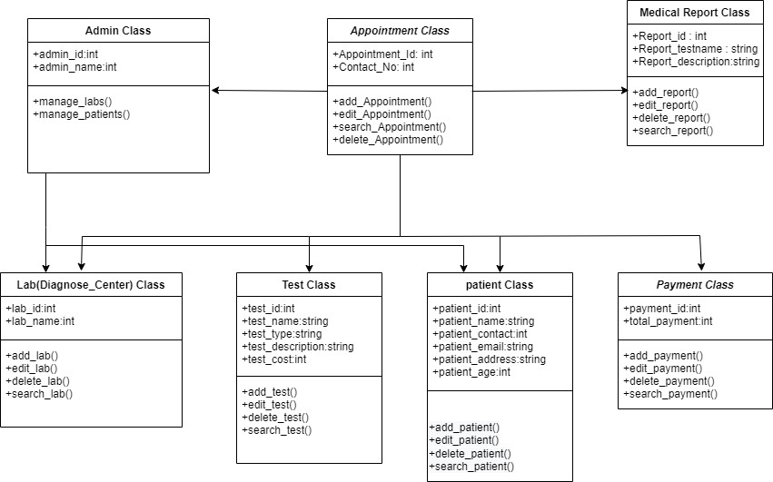
Class Diagram

Slide 18
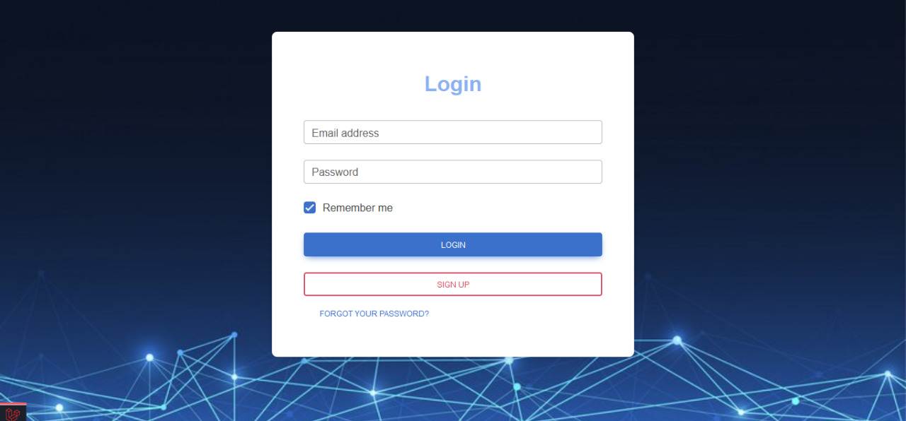
Screens
Login Screen

Slide 19
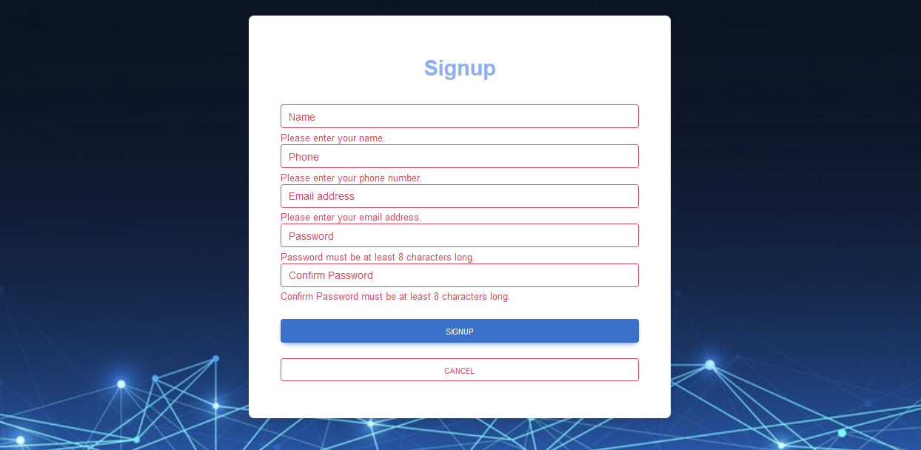
Form Validation:

Slide 20
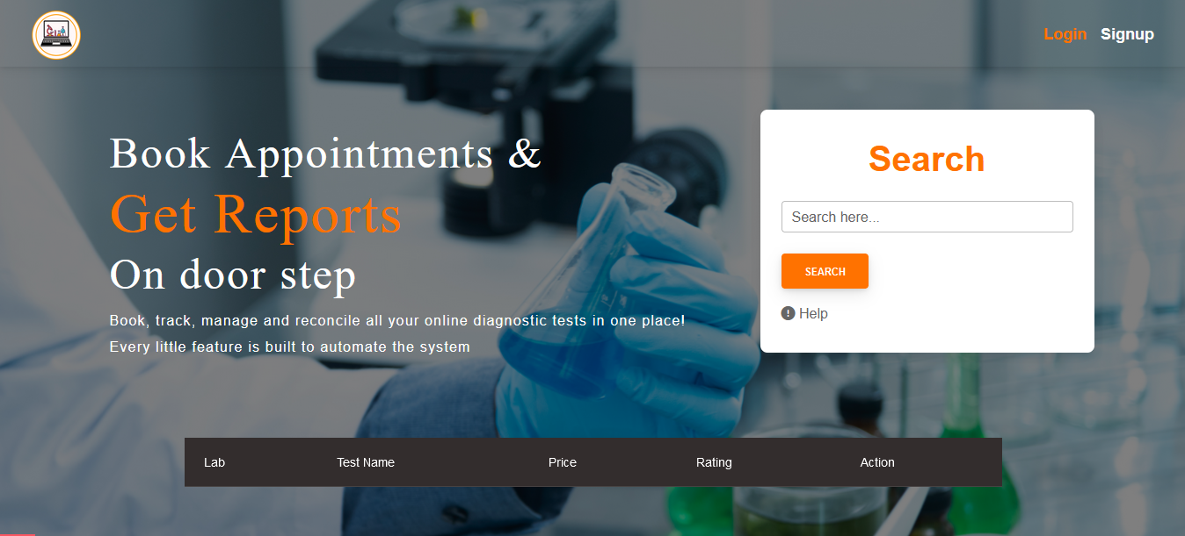
Home Screen

Slide 21
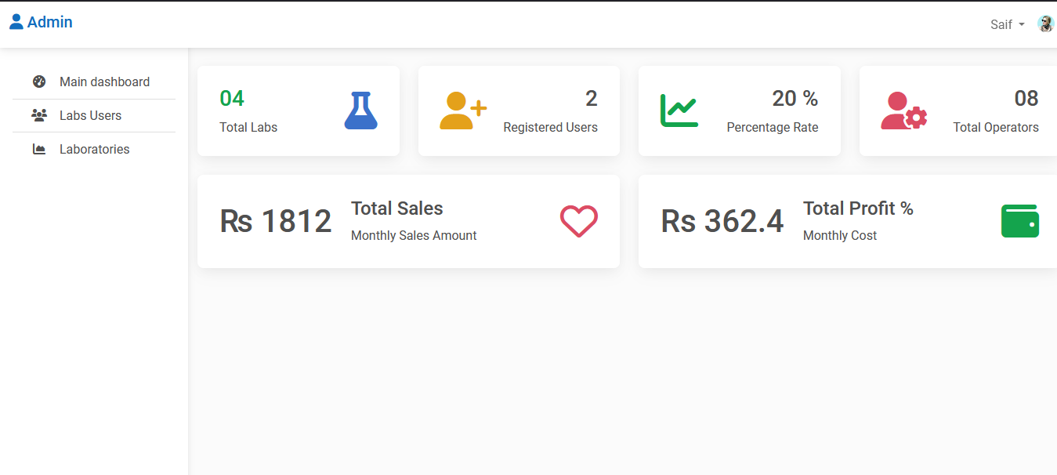
Admin Dashboard

Slide 22
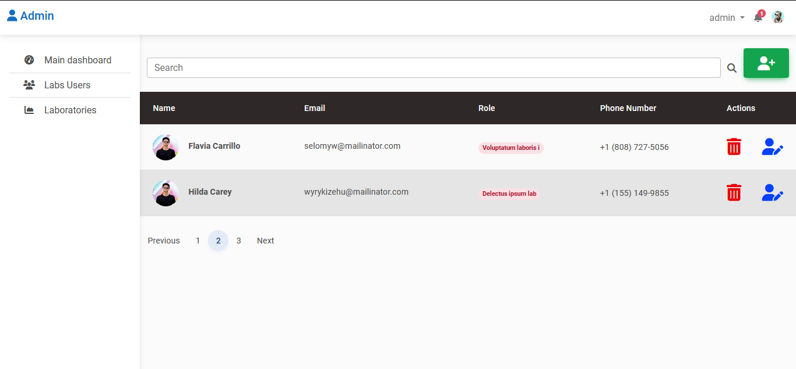
Laboratories Detail Screen

Slide 23
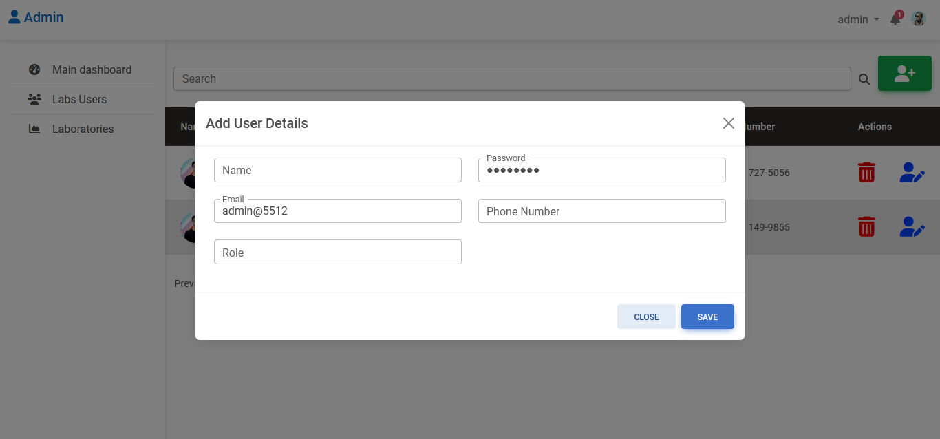
Add Laboratory Screen

Slide 24
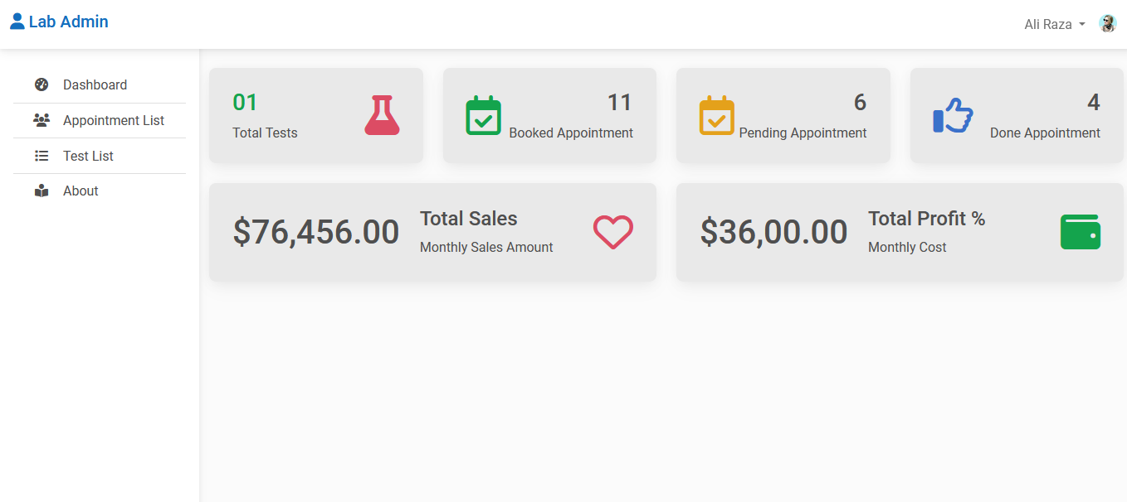
Lab Dashboard

Slide 25
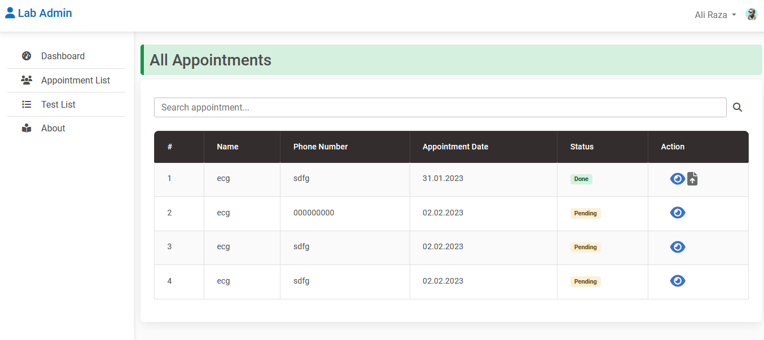
Lab (Booked Appointments)

Slide 26
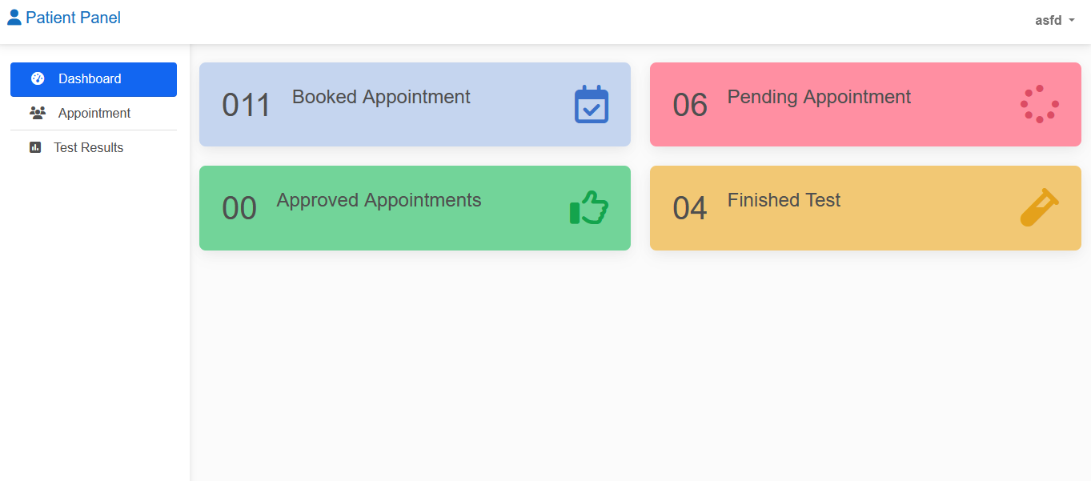
Patient Dashboard

Slide 27
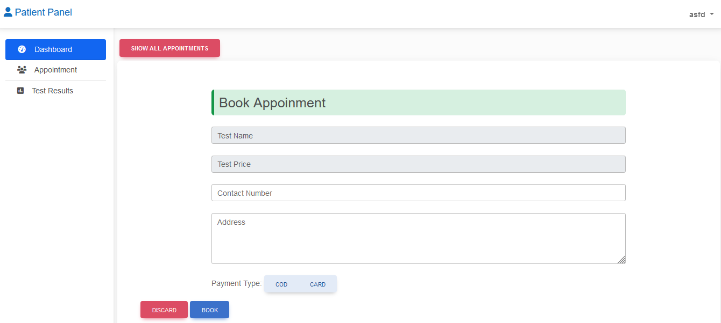
Patient Dashboard(Appointments)

Slide 28
Conclusion
This system is designed for Diagnostic center to replace their existing manual paper-based system. Diagnostic services are critical to delivering high-quality patient care, but constantly changing reimbursement levels, rapidly evolving technology, and chronic shortages of skilled professionals can be daunting. Since we are entering details of the patients and their diagnostic information electronically in the “Online Diagnostic Lab System”, data will be secured.

Slide 29
JazakAllah

